Slide 1



CALIBIR Bootcamp 2023: Imaging Informatics
Bayram Annanurov, Mostafa Rezapour, and Ziyu Su
school.wakehealth.edu/wfbmi @WFBMI linkedin.com/wfcbmi

Slide 2
Digital Image Processing
Ziyu Su

Slide 3
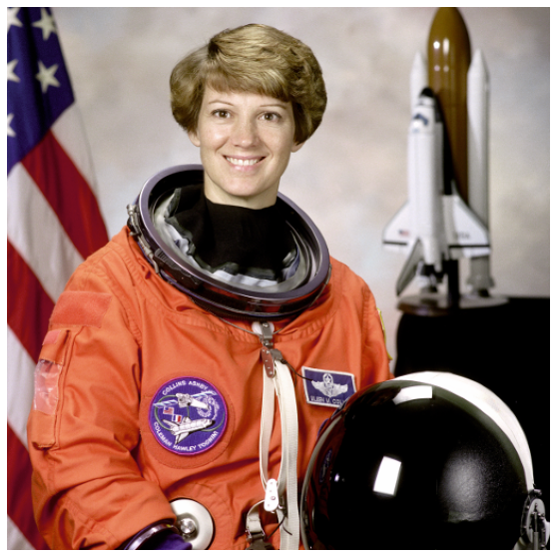
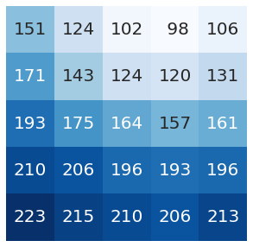
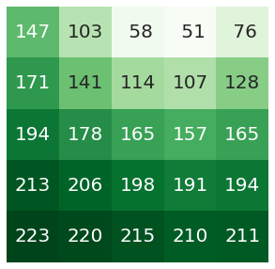
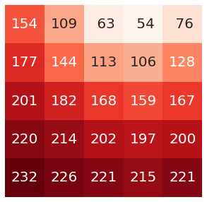
What is digital image?
An image may be defined as an array. Each element is called a pixel.

Slide 4
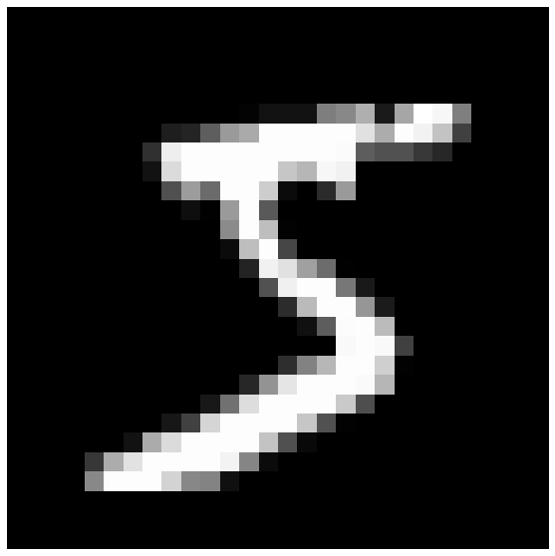
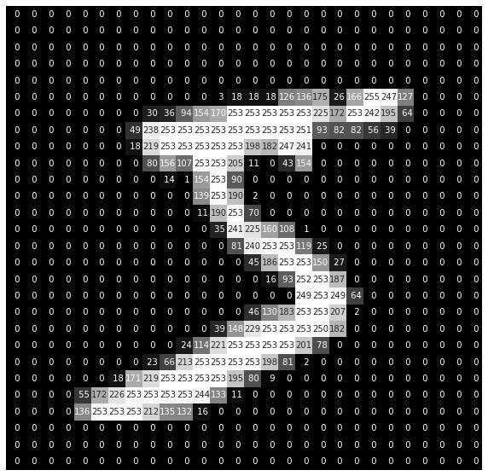
What is digital image?
Pixels have corresponding intensity values, usually ranging from 0 to 255, that represent the brightness of those pixels.

Slide 5
Grayscale images
A grayscale image is one in which the value of each pixel is a single number representing an amount of brightness.
Notes:
Refer to: https://en.wikipedia.org/wiki/Grayscale

Slide 6
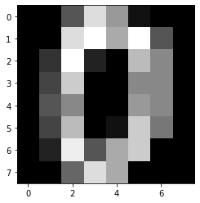
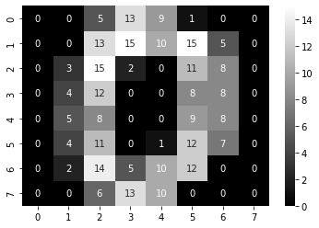
Grayscale images
Images are saved as arrays.
Grayscale image can be treated as a matrix
Visualize an example image using Python and see how an image is represented by a matrix.

Slide 7
Color image
A color image is a stack of three matrices that represent “red”, “green”, and “blue” separately.

Slide 8
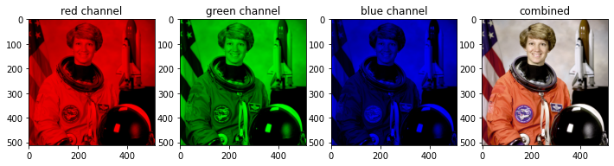
Color image
A color image is a stack of three matrices that represent “red”, “green”, and “blue” separately.
Each matrix is called a color channel
Visualize each channel separately
Color image
Visualization of each channel
Notes:
Explain what is channel

Slide 9
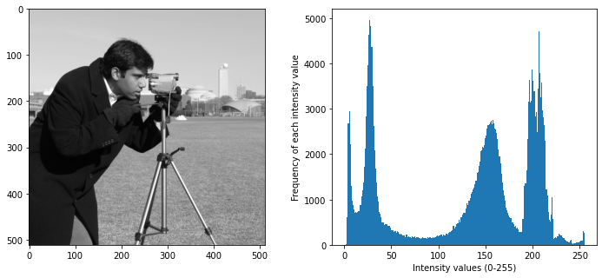
Image processing basics
Observe an image using a histogram.
Histogram is an important feature of an image.
It depicts the frequency of each intensity level, ranging from 0 to 255, of an image.

Slide 10
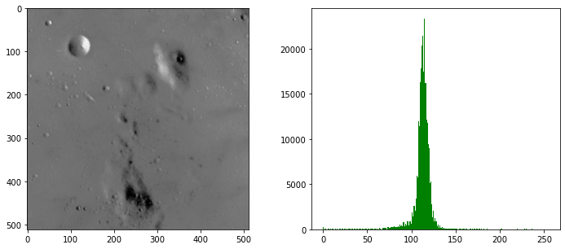
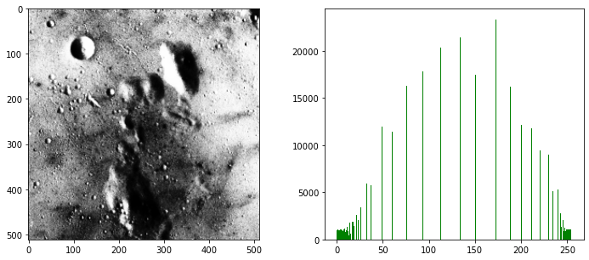
Image processing basics
Observe a moon surface image using histogram.
Original
Contrast enhanced
Notes:
We don’t use the entire band normally. …enhancement is like stretching the band

Slide 11
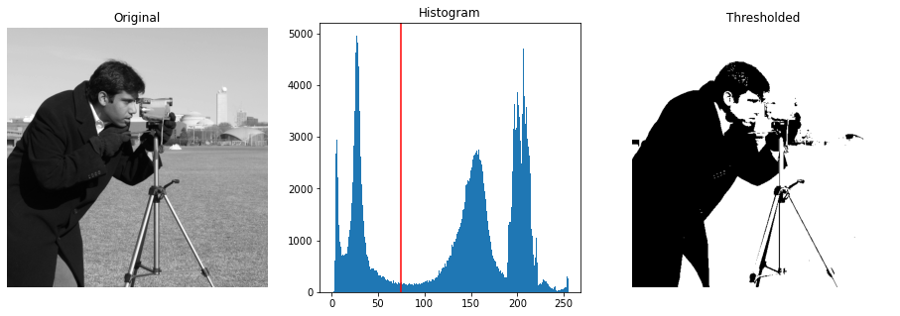
Image processing basics
Image thresholding to segment objects from an image.
=0
=255
75

Slide 12
Image processing basics
Image thresholding to segment objects from an image.
Try other thresholds, and see what you get.

Slide 13
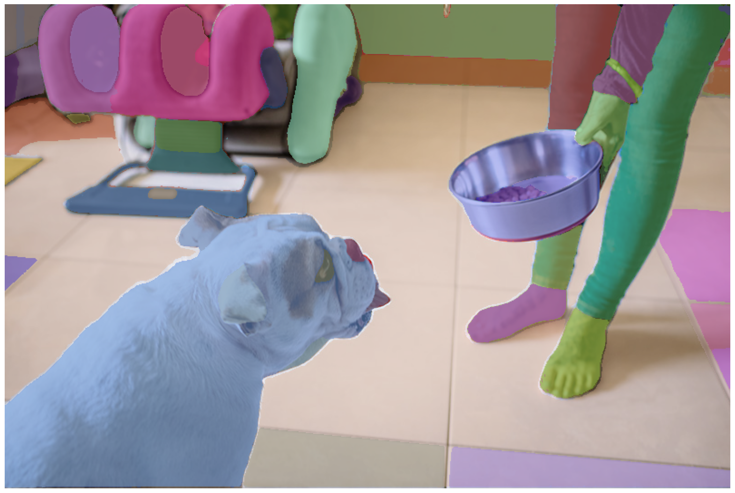
Image processing basics
Image thresholding to segment objects from an image.
More methods to perform segmentations:
Otsu thresholding
Watershed
Deep learning models
Segment anything model from Meta Research

Slide 14
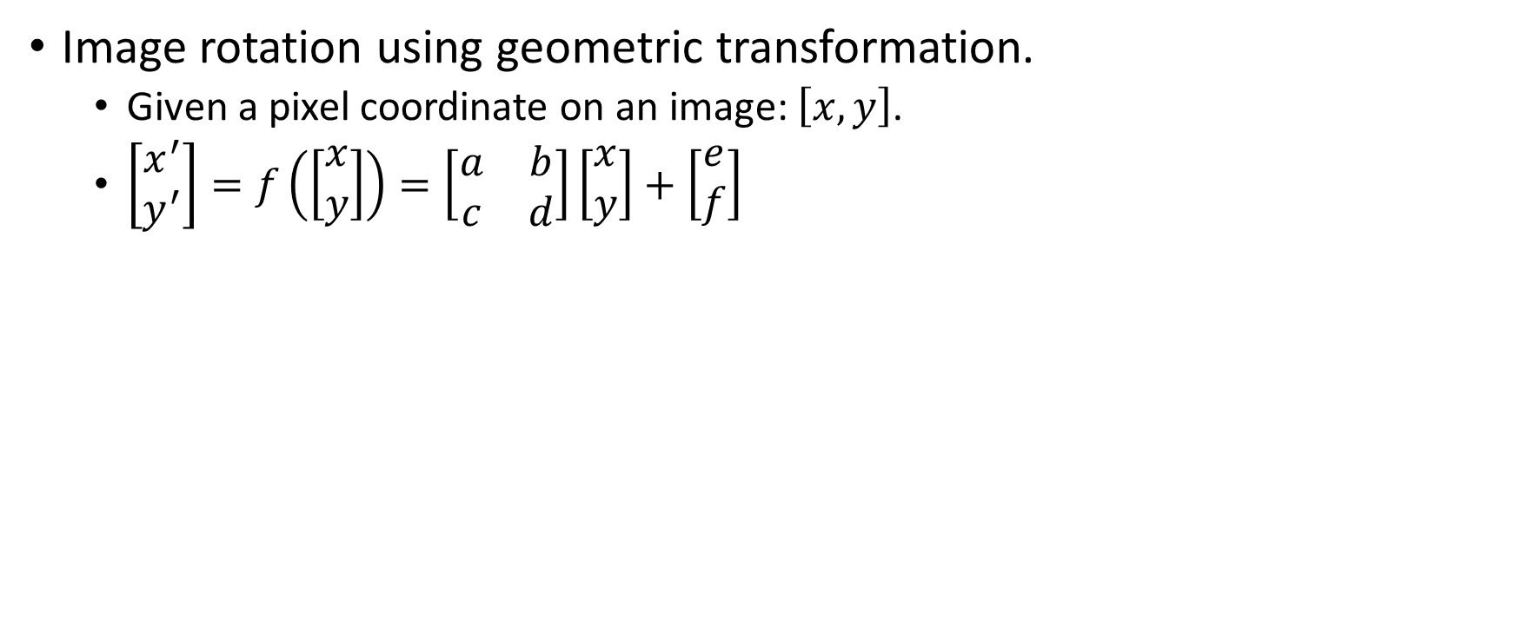
Image processing basics
Image rotation using geometric transformation.
Given a pixel coordinate on an image: $\left[x, y\right]$.
$\left[\begin{matrix}x^{′} \\ y^{′}\end{matrix}\right]=f\left(\left[\begin{matrix}x \\ y\end{matrix}\right]\right)=\left[\begin{matrix}a & b \\ c & d\end{matrix}\right]\left[\begin{matrix}x \\ y\end{matrix}\right]+\left[\begin{matrix}e \\ f\end{matrix}\right]$

Slide 15
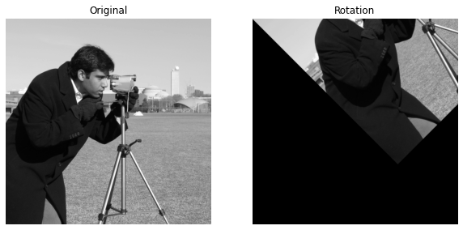
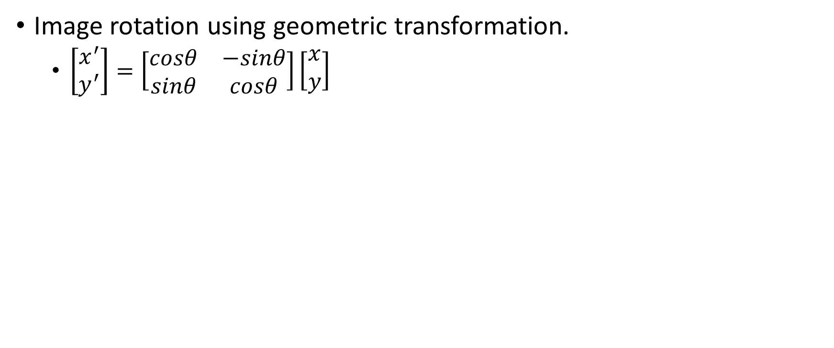
Image processing basics
Image rotation using geometric transformation.
$\left[\begin{matrix}x^{′} \\ y^{′}\end{matrix}\right]=\left[\begin{matrix}cosθ & −sinθ \\ sinθ & cosθ\end{matrix}\right]\left[\begin{matrix}x \\ y\end{matrix}\right]$

Slide 16
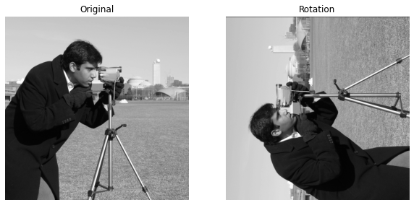
Image processing basics
Image rotation using geometric transformation.
Rotate the image with different angles, and see the results

Slide 17
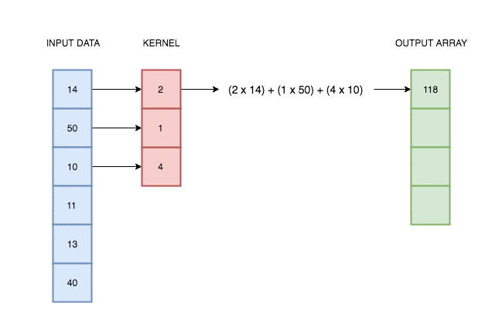
Image processing basics
Image convolution with kernel.
1-D example
Kernel moving on a vector

Slide 18

Image processing basics
Image convolution with kernel.
Image is a 2-D data:
Image
Kernel
Feature
Kernel moving on the image

Slide 19
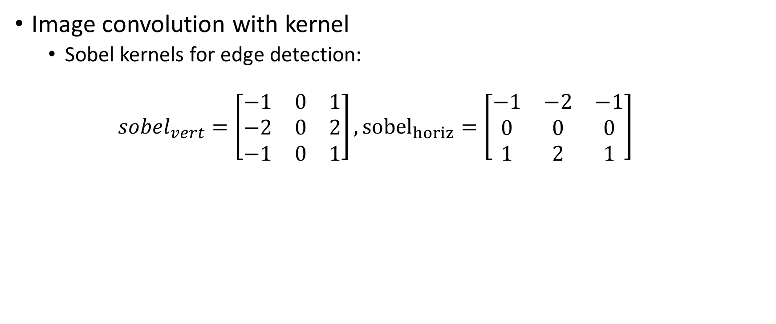
Image processing basics
Image convolution with kernel
Sobel kernels for edge detection:
$$sobel_{vert}=\left[\begin{matrix}−1 & 0 & 1 \\ −2 & 0 & 2 \\ −1 & 0 & 1\end{matrix}\right], {sobel}_{horiz}=\left[\begin{matrix}−1 & −2 & −1 \\ 0 & 0 & 0 \\ 1 & 2 & 1\end{matrix}\right]$$

Slide 20
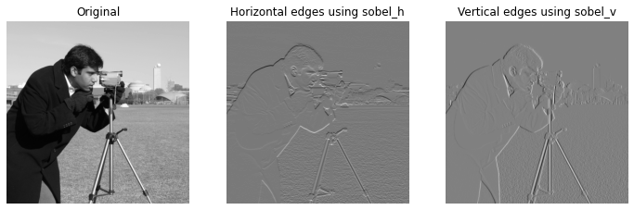
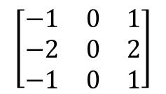
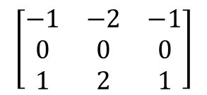
Image processing basics
Image convolution with kernel
Sobel kernels for edge detection:
$$\left[\begin{matrix}−1 & −2 & −1 \\ 0 & 0 & 0 \\ 1 & 2 & 1\end{matrix}\right]$$
$$\left[\begin{matrix}−1 & 0 & 1 \\ −2 & 0 & 2 \\ −1 & 0 & 1\end{matrix}\right]$$

Slide 21
Convolutional Neural Networks
Ziyu Su

Slide 22
What is CNN?
Convolutional neural networks (CNN) is a class of neural network most commonly applied to analyze images.

Slide 23
What is CNN?
Convolutional neural networks (CNN) is a class of neural network most commonly applied to analyze images.
Convolution kernels learned by deep learning strategy.
Traditional convolution kernels: Humanly defined. Limited by human bias.
CNN: Automatically learned. Improved feature extraction.

Slide 24
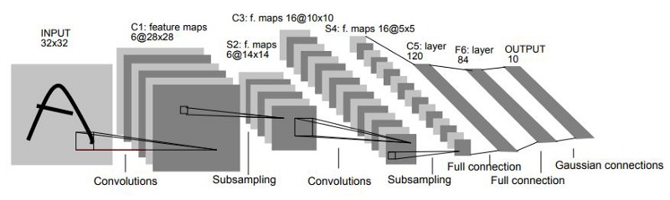
What is CNN?
Convolutional neural networks (CNN) is a class of neural network most commonly applied to analyze images.
Convolution kernels learned by deep learning strategy.
Traditional convolution kernels: Humanly defined. Limited by human bias.
CNN: Automatically learned. Improved feature extraction.
Convolutions are applied hierarchically (multi-layer) for high-level feature expression.
LeNet-5 (LeCun et al., 1998)

Slide 25
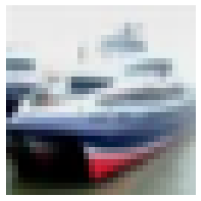
CNN basics
How does the convolution results look like?
Ship
C_layer 1
C_layer 2
F_layer 2

Slide 26
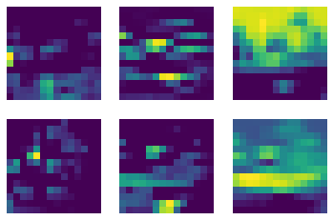
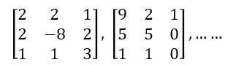
CNN basics
How does the convolution results look like?
Features in C_layer 1
Ship
C_layer 1
C_layer 2
F_layer 2
$\left[\begin{matrix}2 & 2 & 1 \\ 2 & −8 & 2 \\ 1 & 1 & 3\end{matrix}\right],$ $\left[\begin{matrix}9 & 2 & 1 \\ 5 & 5 & 0 \\ 1 & 1 & 0\end{matrix}\right], ……$

Slide 27
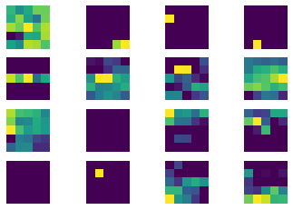
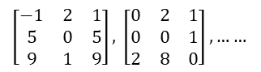
CNN basics
How does the convolution results look like?
Features in C_layer 2
Ship
C_layer 1
C_layer 2
F_layer 2
$\left[\begin{matrix}−1 & 2 & 1 \\ 5 & 0 & 5 \\ 9 & 1 & 9\end{matrix}\right],$ $\left[\begin{matrix}0 & 2 & 1 \\ 0 & 0 & 1 \\ 2 & 8 & 0\end{matrix}\right], ……$

Slide 28
CNN basics
Forward propagation (convolution operation):
Convolution layer-by-layer
Get high-level image features from the last layer
Make prediction from feature
Prediction: Car!
C_layer 1
C_layer 2
F_layer 2

Slide 29
CNN basics
Backpropagation (update the kernels according to the forward results):
Compute prediction error
Update kernels layer-by-layer using gradient descent strategy
Prediction: Car!
Truth: Ship!
C_layer 1
C_layer 2
F_layer 2

Slide 30
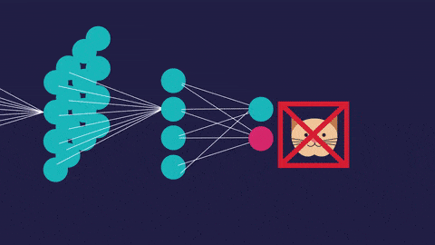
CNN basics
Backpropagation (update the kernels according to the forward results):
Image credits: https://blog.paradisetechsoft.com/a-brief-guide-to-cnn-convolutional-neural-networks/

Slide 31
CNN basics
for i=1:n
Forward propagation
Backpropagation

Slide 32
CNN basics
Pros:
High-level feature expression
Automatically learned for specific problems
Reduced human bias
Cons:
Data hungry
Interpretability issue

Slide 33
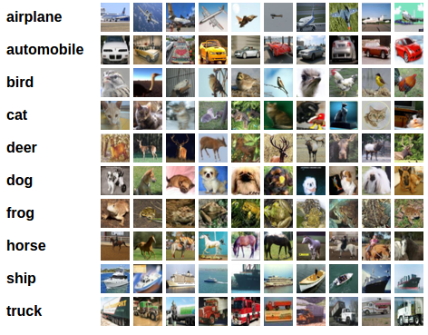
CNN basics
Applications:
Classification

Slide 34
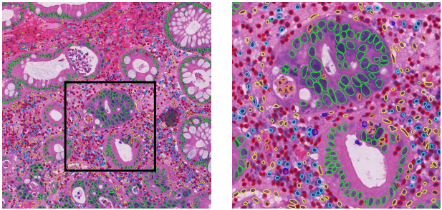
CNN basics
Applications:
Segmentation

Slide 35
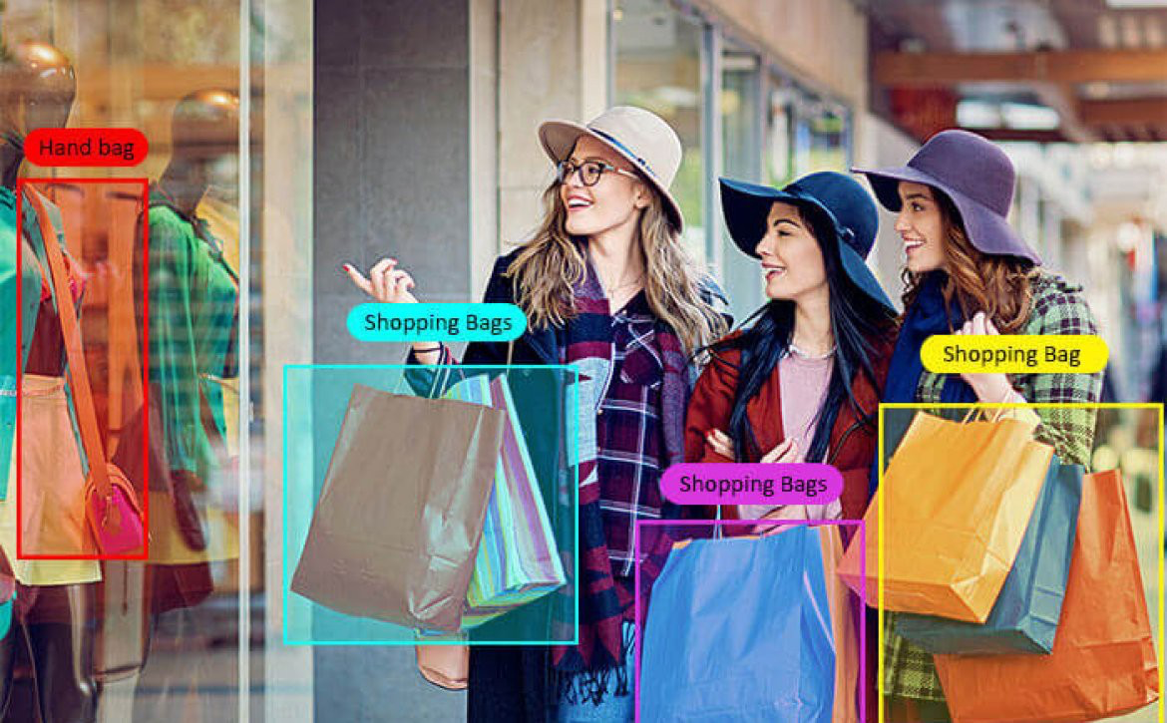
CNN basics
Applications:
Detection

Slide 36
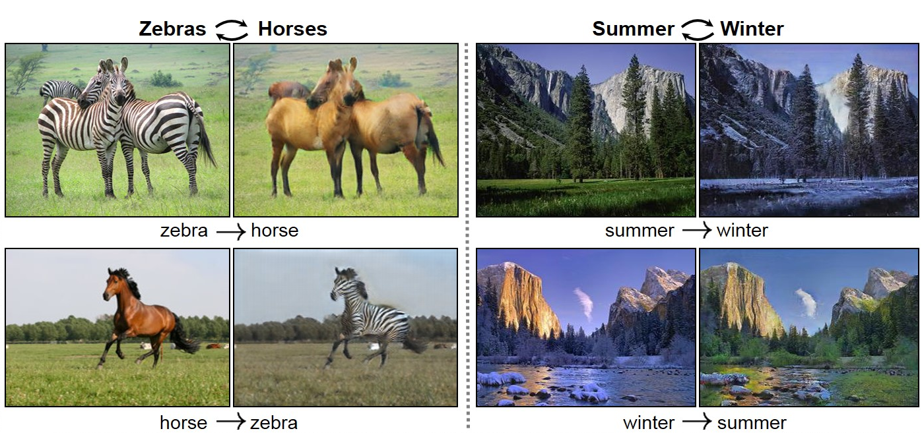
CNN basics
Applications:
Generation
……

Slide 37
Preprocessing Annotations
Bayram Annanurov

Slide 38

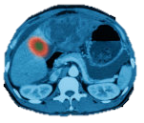

AI vs Doctors
1x + 1x = 1x

Slide 39
AI vs Doctors
1x + 1x = 1x
1x + 10000x = 10000x

Slide 40

AI vs Doctors
1x + 1x = 1x
1x + 10000x = 10000x
1x + 10000 = 0.1x

Slide 41
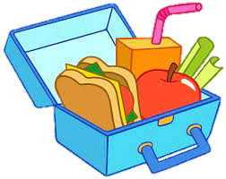
AI is like a child
Can take only one sandwich in a lunchbox
Sandwich must be assembled beforehand
Images must be preprocessed before being sent to a Neural Net
Resize / rotate the image
Normalize color
Split into standard patches
Toss all irrelevant parts (use annotations)

Slide 42
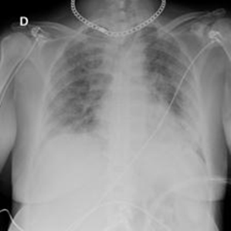
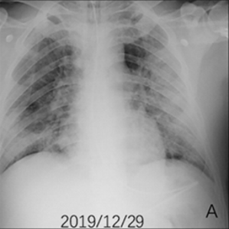
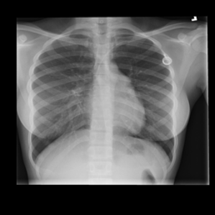
Introduction
Images come from machines
Some parts may not be relevant to research
Preprocessing
Deal with machine marks, foreign objects, incoherent geometry, etc
Remove surrounding tissue and organs from being sent to the algorithm.
kaggle.com/datasets/preetviradiya/covid19-radiography-dataset

Slide 43
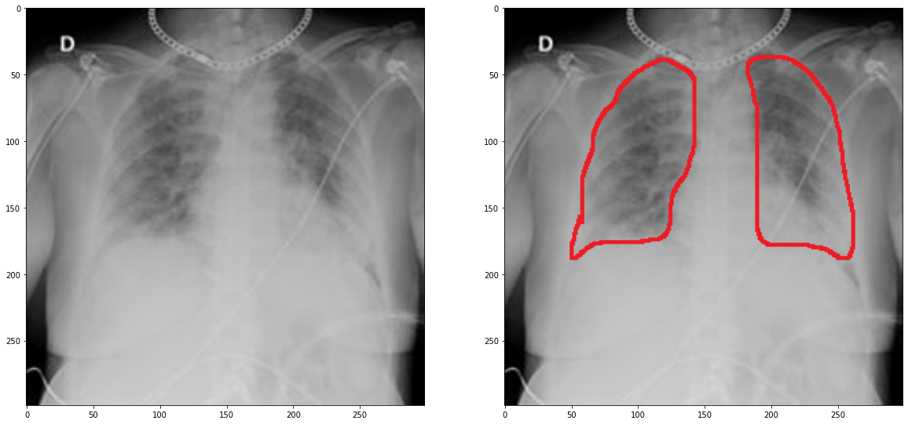
Human Annotation
MDs provide insight on the Region of Interest (ROI)
Paint (pro: widely available),
ImageScope (pro: less memory, easier processing by *you-the-pythonista*)

Slide 44
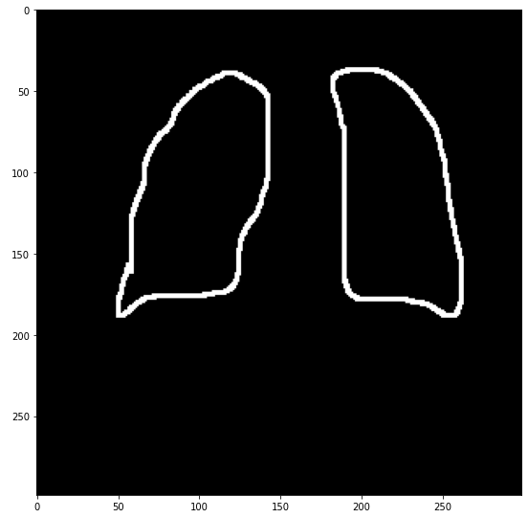
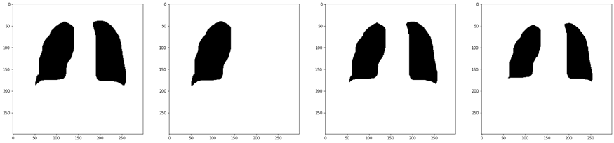
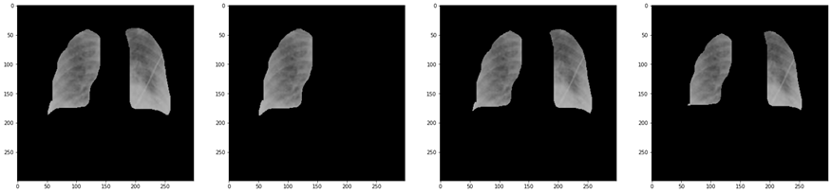
Working with annotations
Differentiating
CV/Graphics methods:
Dilation
Floodfilling
Negation
Masking

Slide 45
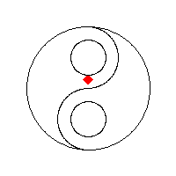
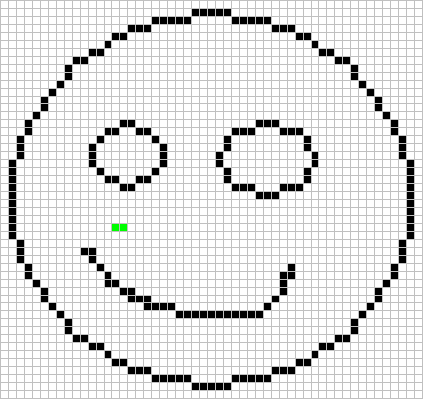
Floodfilling
https://en.wikipedia.org/wiki/Flood_fill

Slide 46
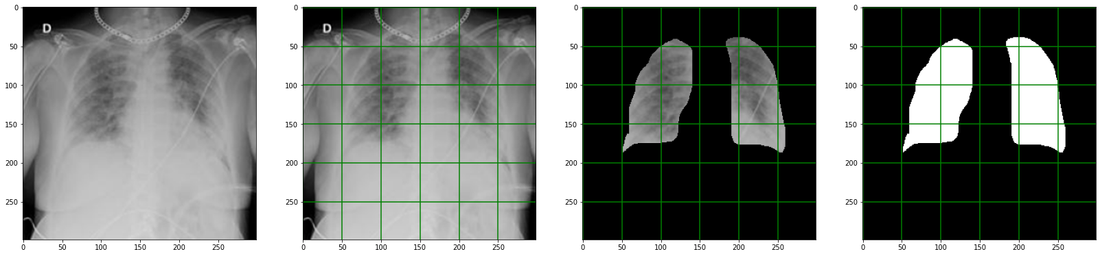
Data for the algorithm
Large images may require partition
Use the partition of the masked image
The mask plays important role
Save your every output!!

Slide 47
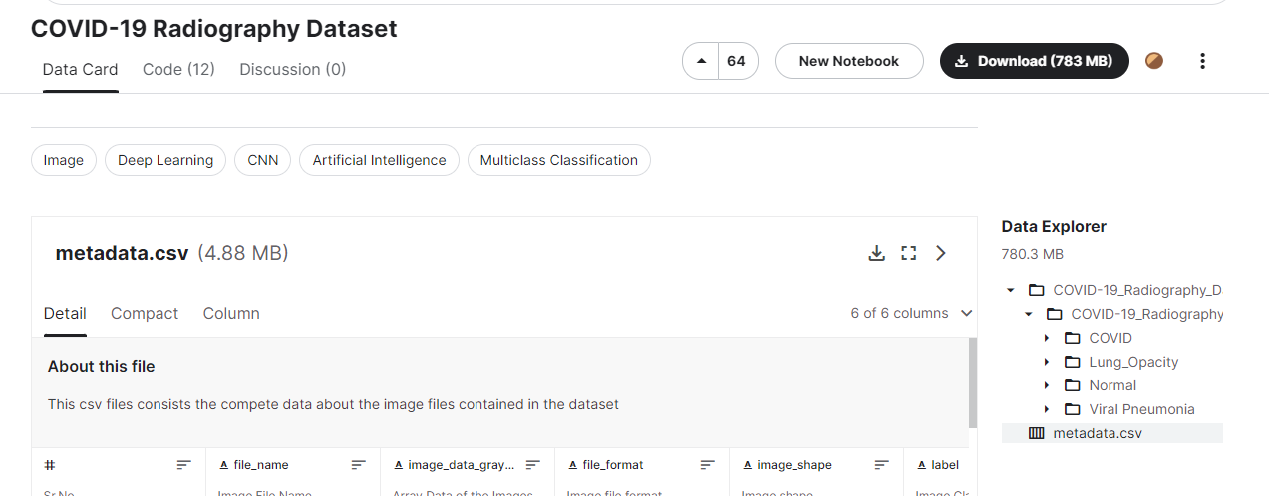
Hands-on
Dataset: kaggle.com/datasets/preetviradiya/covid19-radiography-dataset
X-rays of lungs: Normal (Healthy), Covid, etc
Download
N images from Normal set
N images from COVID set
N == 1 for today
Organize images
Produce annotations
Follow the me in Jupyter

Slide 48
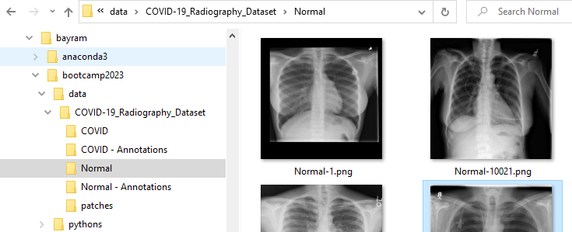
Hands-on
Dataset: kaggle.com/datasets/preetviradiya/covid19-radiography-dataset
X-rays of lungs: Normal (Healthy), Covid, etc
Download
N images from Normal set
N images from COVID set
N == 1 for today
Organize images
Produce annotations
Follow the me in Jupyter

